Slide 1
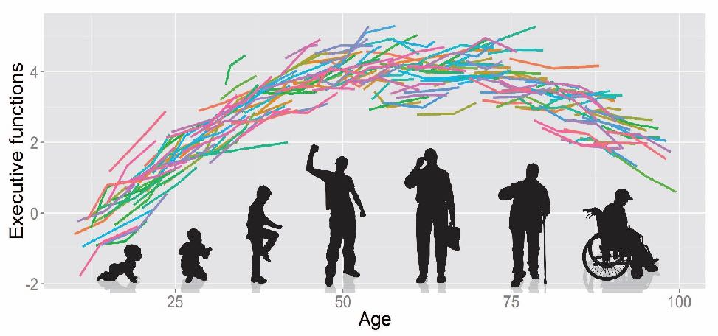
An introduction to Latent Growth Curve Modeling
Rogier A. Kievit
Lifespan Cognitive Dynamics Group
rogier.kievit@radboudumc.nl

Slide 2
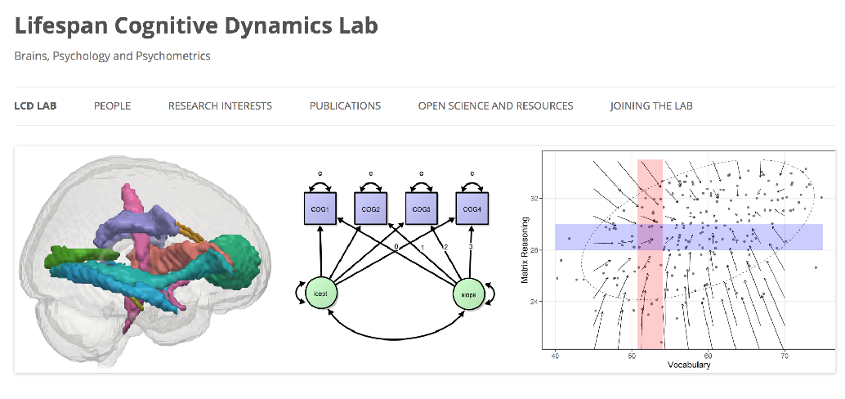


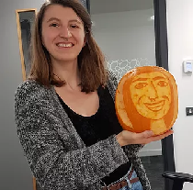
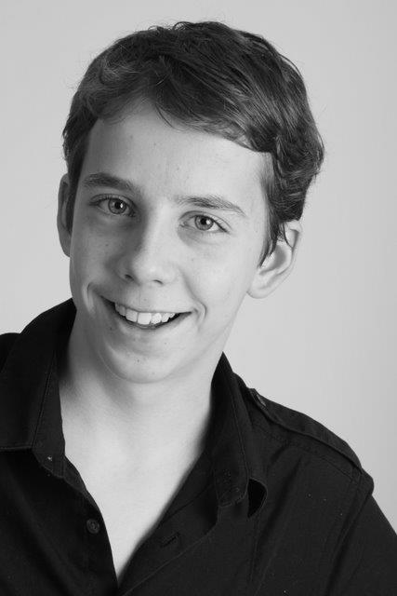






How, and why, do cognitive abilities change across the lifespan?
(SEM) Model based, theory driven developmental cognitive neuroscience
Rogier Kievit
Jessica
Schaaf
Ilse Coolen
Jordy van Langen
Eleni
Zimianiti
Michael
Aristodemou
Lea
Michel
Aran van Hout
Nick Judd
Emma Meeussen
Feline van Aagten

Slide 3




Outline
Magda Lazari
1) Why study change?
2) Structural Equation Modeling – Getting started
3) Latent growth curve modeling
4) DIY
Léa Michel
Nick Judd

Slide 4
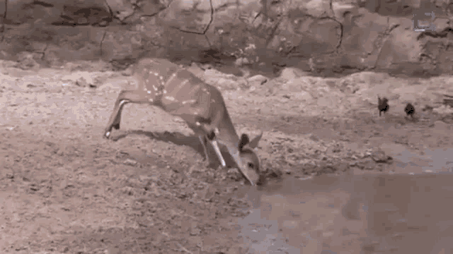
From snapshots to change
Classic approach: ‘High resolution’ snapshot of brain structure, behavioural phenotypes
7 Tesla, Connectom; better questionnaires, better tests
But: Does not capture change or development
To study development we should study change

Slide 5
Why study change?
1) How do people change?
2) How do individuals differ in change?
3) How do changes co-occur?
4) What predicts – or is predicted by – change?
Baltes, P. B., & Nesselroade, J. R. (Eds.). (1979). Longitudinal research in the study of behavior and development. Academic Press.

Slide 6
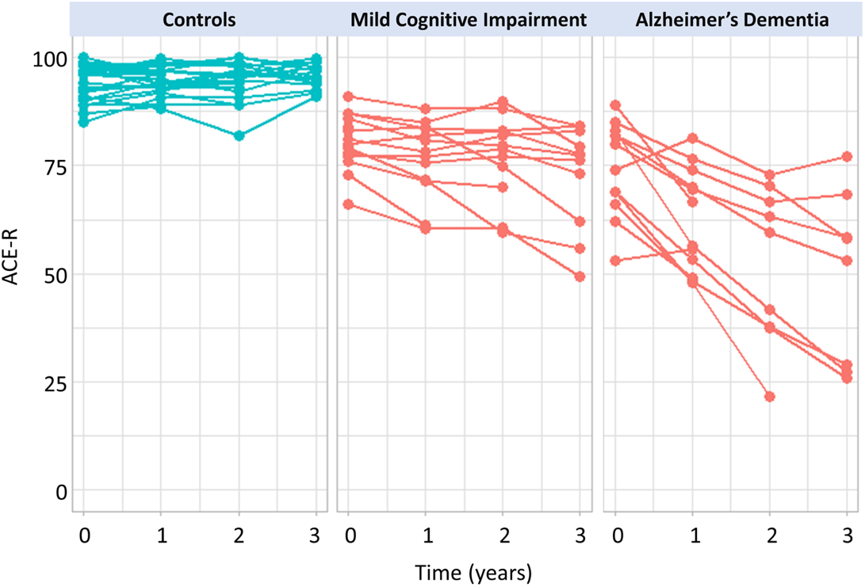
Example: Modeling decline in dementia
Group comparison: Do groups differ in their mean linear slope?
Groups differed significantly in their slopes
Differences in slopes are predicted by tau burden
Malpetti, M., Kievit, R. A., Passamonti, L., Jones, P. S., Tsvetanov, K. A., Rittman, T., ... & Rowe, J. B. (2020). Microglial activation and tau burden predict cognitive decline in Alzheimer’s disease. Brain, 143(5), 1588-1602.

Slide 7
How do behavioural and neural phenotypes co-develop in childhood and early adolescence?
99% of Developmental Cognitive Neuroscience: Age heterogeneous differences
Increase focus on three (empirically) underrepresented questions
1) Do changes in brain structure and behavioral characteristics go hand in hand?
2) Does brain structure drive the emergence of behavioural characteristics?
3) Do behavioural differences drive neural change?
Behavioural differences
Behavioural changes
Neural differences
Neural changes
Kievit, R., & Simpson-Kent, I. L. (2019). It’s About Time: Towards a Longitudinal Cognitive Neuroscience of Intelligence. https://psyarxiv.com/n2yg7/

Slide 8
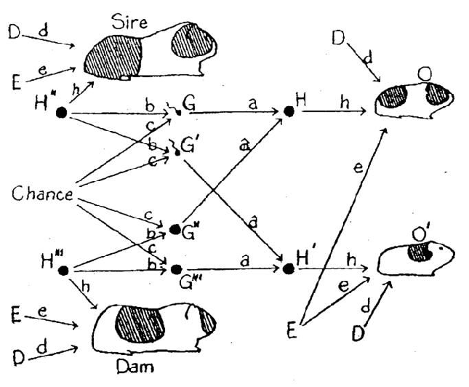
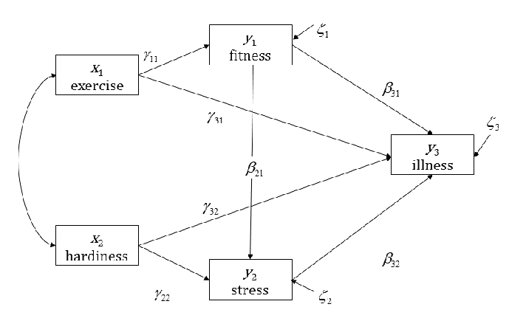
What is structural equation modeling (SEM)?
A combination of two tools
Path analysis
Sewall Wright (1921)
Unique: path can be the cause and consequence at the same time
Estimated simultaneously
Latent variable analysis
Relating measured variables to hypothesized constructs

Slide 9
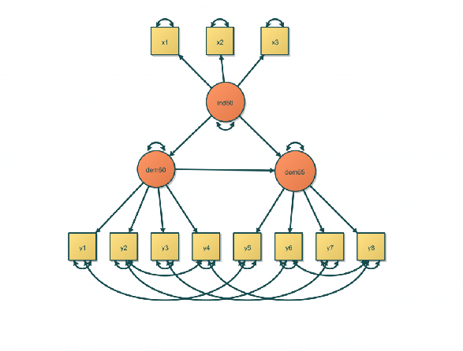
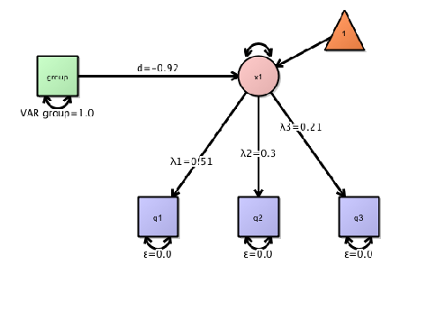
One-to-one mapping between graphical representation and matrix algebra If you can draw your hypothesis, you can (likely) fit it as a model
Graphical representation
Observed variable
Latent variable
Directed relationship
(e.g. factor loadings, regressions)
Undirected relationship
(e.g. (co)variance, error)

Slide 10
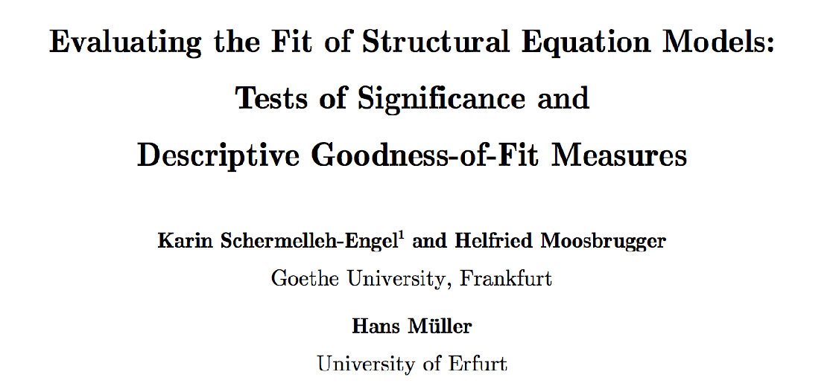
Model fitting in SEM
1. Overall model fit: chi square test
2. Model fit: Comparative fit indices
3. Model fit: Model misfit
4. Comparative model fit
5. Parameter estimates

Slide 11
1. Chi square test
Basic principle: Test of perfect model fit
We have a proposed model
IF that model generated our data…
THEN we know the expected misfit of the data to this model
Chi square, with k degrees of freedom
If the data deviates significantly more than expected…
Then the hypothesis of perfect fit is rejected

Slide 12


Different..
Standard stats
P<0.05
SEM

Slide 13
2. Model fit: Comparative fit indices
Basic idea: How much better does my model perform than a baseline, reference (e.g. independence) model?
Conceptually similar to (adjusted) r-squared: given my model complexity, how well do I explain the data
Range: 0-1
Cutoff: >0.95-0.97
Examples:
CFI, TLI, NNFI, GFI

Slide 14
3. Model fit: Model misfit indices
Basic idea: How wrong is my fitted model?
Conceptually: what is the average wrongness
Examples:
RMSEA, SRMR
Range: ~0-1
Cutoffs: <0.08-0.05

Slide 15
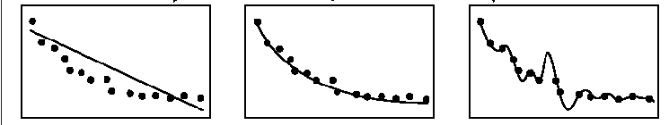
4. Model Comparison A: chi square
The difference in model fit is also chi-square distributed
Only works if models are nested
You can turn model 1 into model 2 by simply freeing parameters
Conceptually:
Does the more complicated model fit significantly better than would be expected just by making any model more (needlessly) complicated
Can also use information criteria (AIC/BIC)

Slide 16
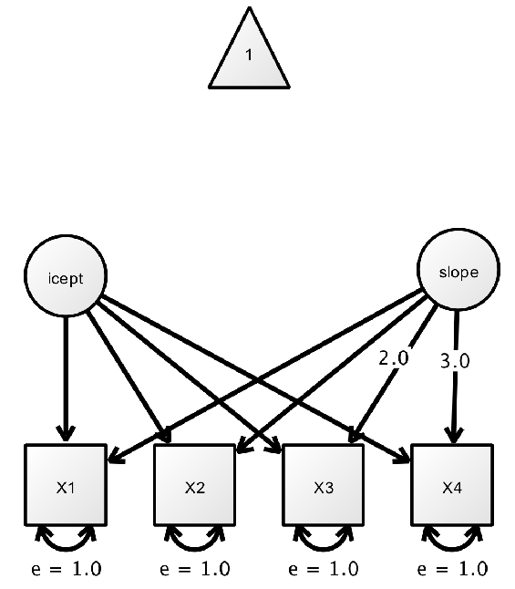
A particular type of SEM: Latent Growth Curve Models
Flexible framework to capture:
Individual differences at baseline
The shape of change
Mean change over time (slope)
Individual differences in change over time (slope variance)
The association between present and future (slope-intercept covariance)
0
1
Kievit et al., (2018). Developmental cognitive neuroscience using latent change score models: A tutorial and applications. Developmental cognitive neuroscience, 33, 99-117.
Duncan & Duncan (2004). An introduction to latent curve modelling. Behaviour Therapy, 35, 333-363.
McNeish, D. & Matta, T. (2017). Differentiating Between Mixed Effects and Latent Curve Approaches to Growth Modeling.

Slide 17
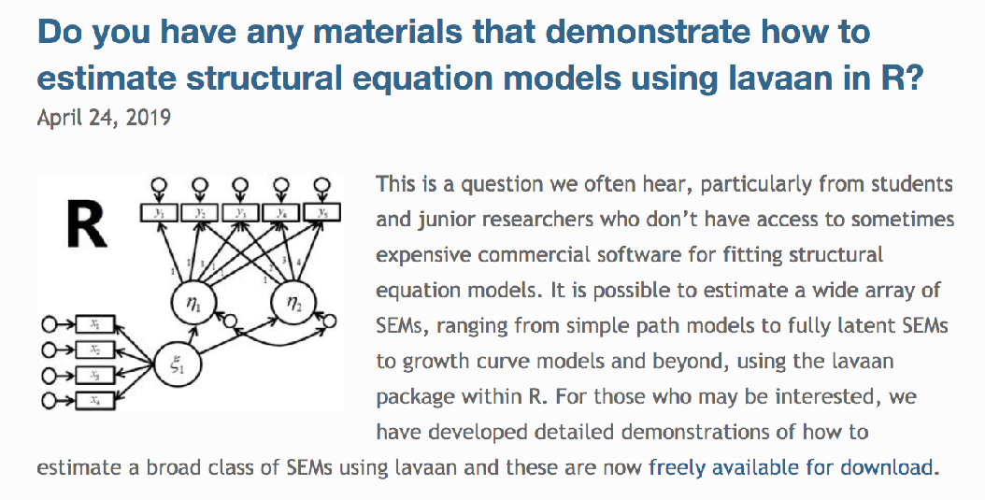
Fitting a latent growth curve in Lavaan
Build up a 3 wave example
model
As graphical model
As syntax

Slide 18
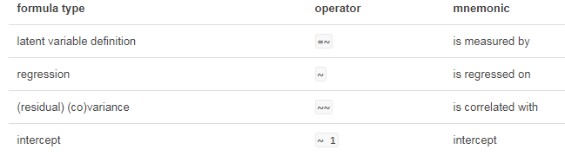
Summary of Formulae Types

Slide 19
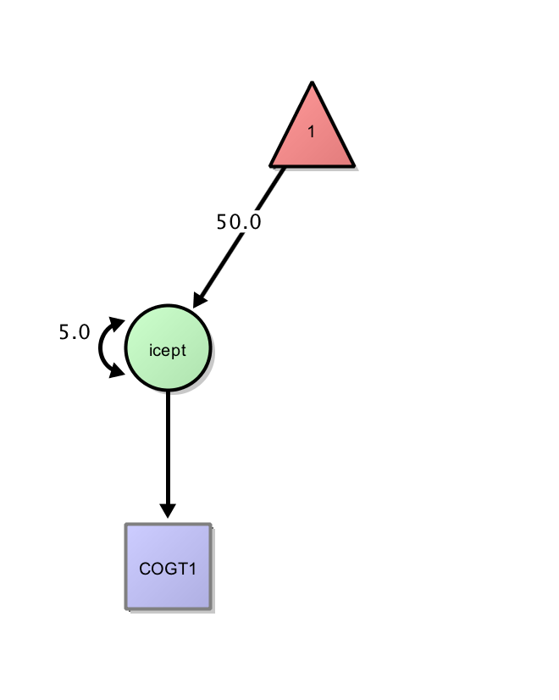
Time 1
'
i=~1*COGT1 #intercept
i~1 #mean
i~~i #variance
'

Slide 20
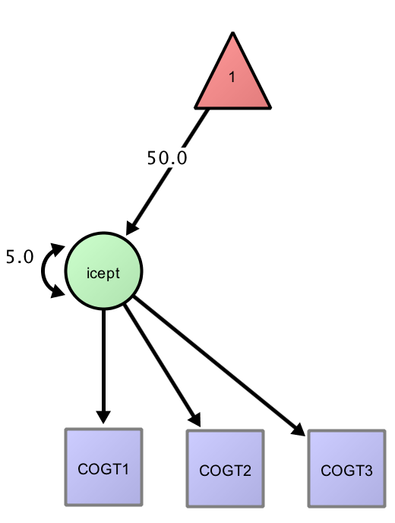
Repeated measures
'
i=~1*COGT1+1*COGT2+1*COGT3
i~1
i~~i
'

Slide 21
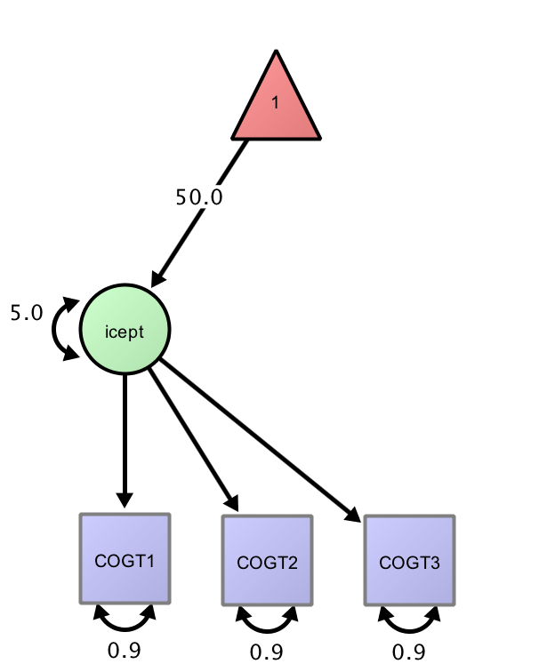
Measurement error
‘
i=~1*COGT1+1*COGT2+1*COGT3
i~1
i~~i
COGT1~~ervar*COGT1
COGT2~~ervar*COGT2
COGT3~~ervar*COGT3
'

Slide 22
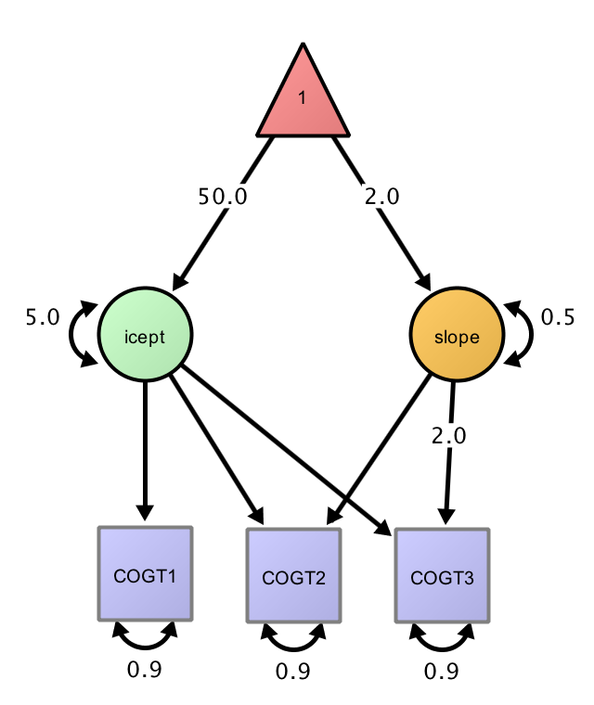
Adding a slope
'
i=~1*COGT1+1*COGT2+1*COGT3
s=~0*COGT1+1*COGT2+2*COGT3
s~~s
'

Slide 23
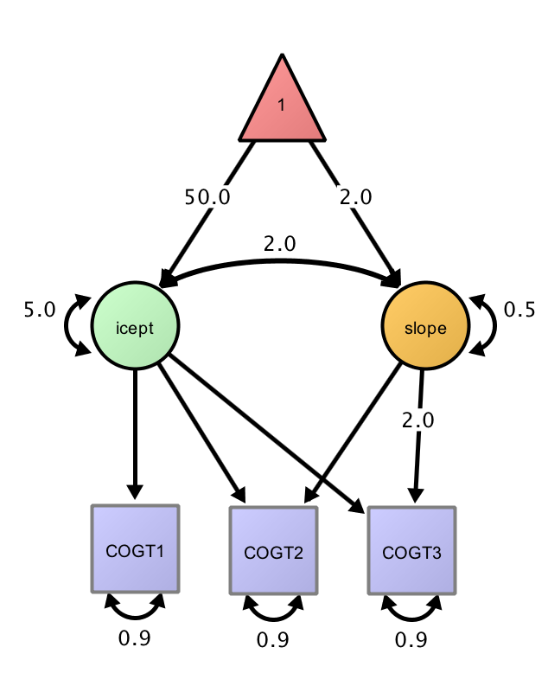
Adding latent covariance
'
i=~1*COGT1+1*COGT2+1*COGT3
s=~0*COGT1+1*COGT2+2*COGT3
s~~i
'

Slide 24
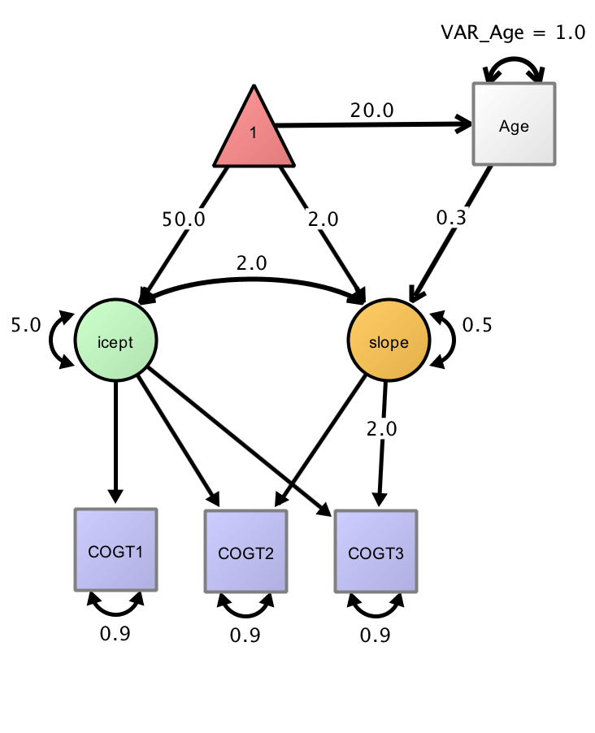
Adding predictors
'
i=~1*COGT1+1*COGT2+1*COGT3
s=~0*COGT1+1*COGT2+2*COGT3
s~~i
s~Age
'
-

Slide 25
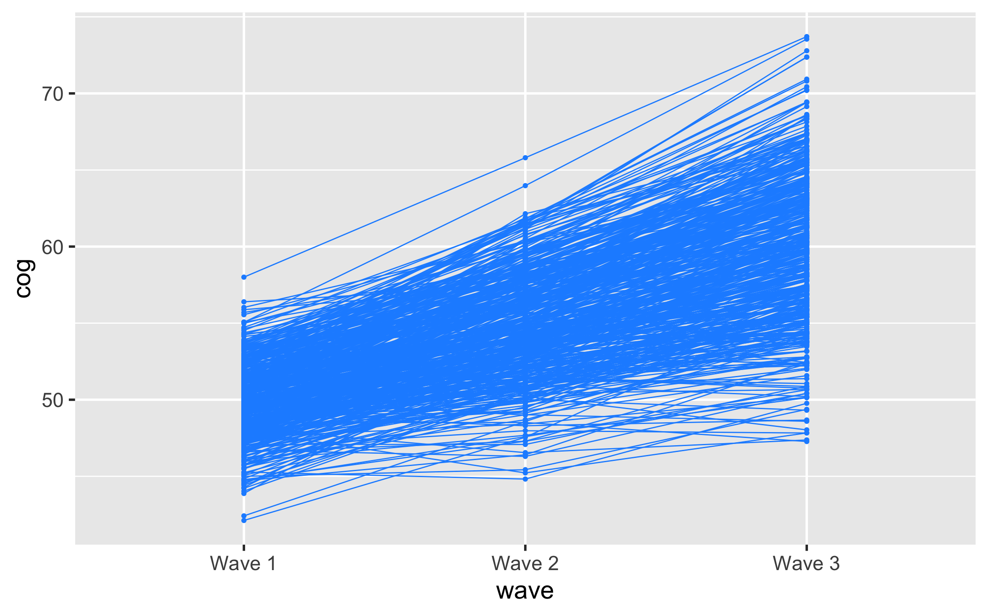
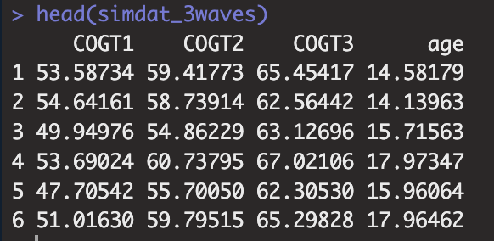
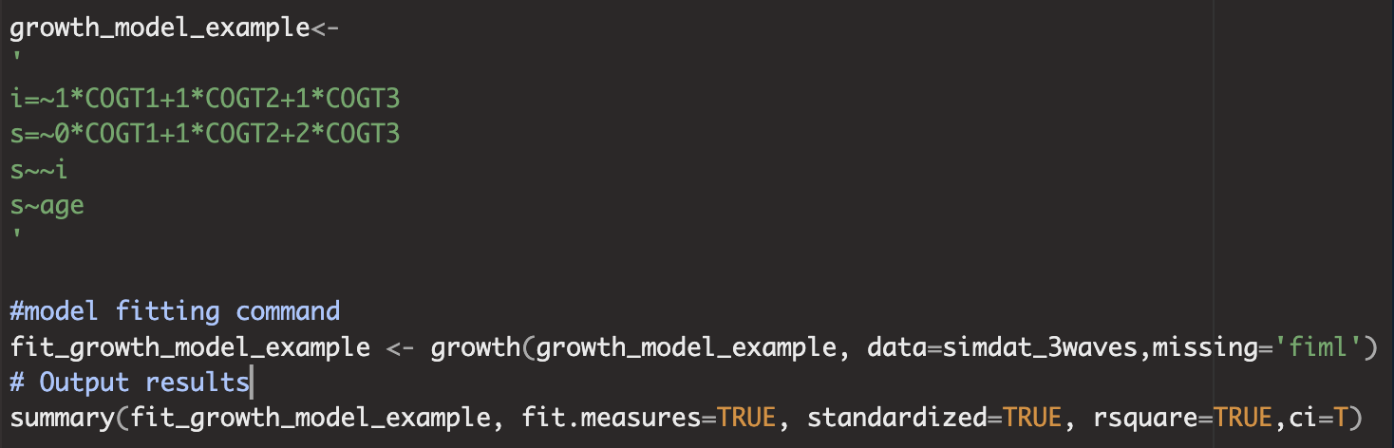
What does this look like in Lavaan?
-The name of my model is ‘growth_model_example’
-The data file is called ‘simdat_3waves’
-The model has:
-an intercept (i)
-a linear slope (s)
-age predicting the rate of change.
-If data is missing I want to use ‘FIML’ (i.e. include all data)

Slide 26
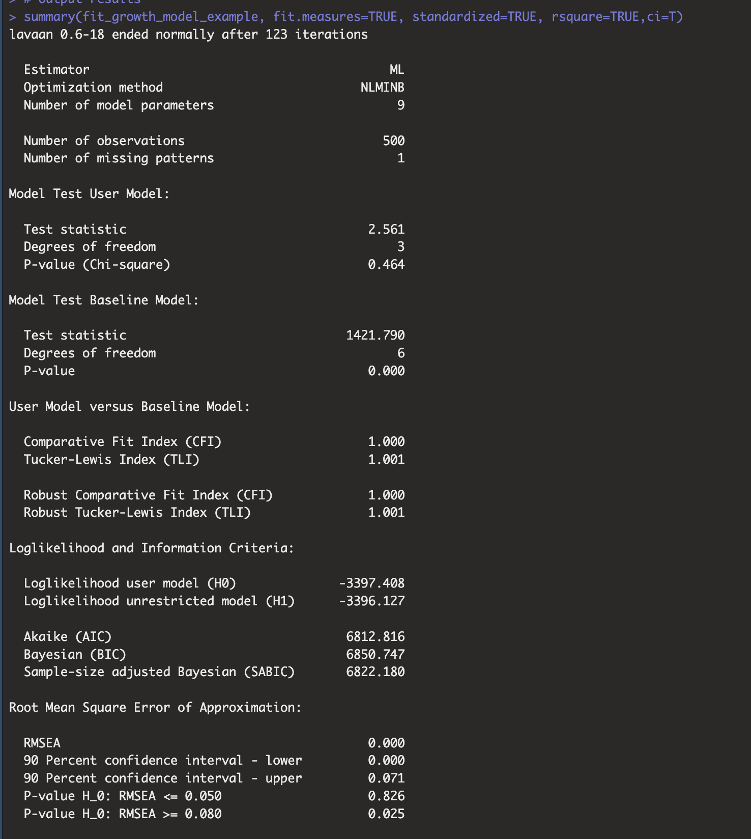
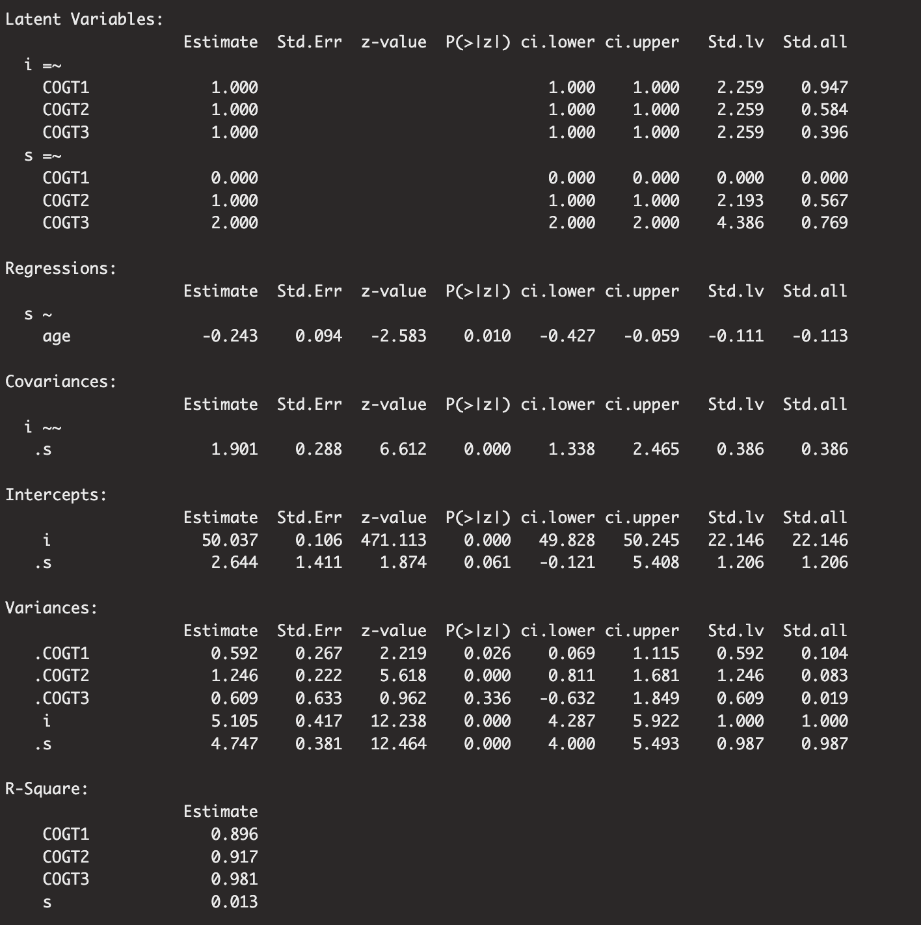
summary(fit_growth_model_example, fit.measures=TRUE, standardized=TRUE, rsquare=TRUE,ci=T)
Step 1: Inspect model fit
Step 2: interpret parameters

Slide 27
Modeling the shape of change
Think through plausible candidates (given waves)
Compare model fit using
Chi-square: Does the more complex model fit significantly better than expected just by chance
AIC/BIC: Does the model fit outweigh the penalty on the number of parameters
3 candidates:
Linear
Quadratic (=linear+quadratic)
Free (‘basis’ model)
Balance explanatory power (fit to data) and parsimony (# parameters)
s_lin =~ 0*t1 + 1*t2 + 2*t3 + 3*t4+4*t5
s_lin =~ 0*t1 + 1*t2 + 2*t3 + 3*t4+4*t5
s_quad =~ 0*t1 + 1*t2 + 4*t3 + 9*t4 +16*t5
s_basis =~ 0*t1 + t2 + t3 + t4+1*t5

Slide 28
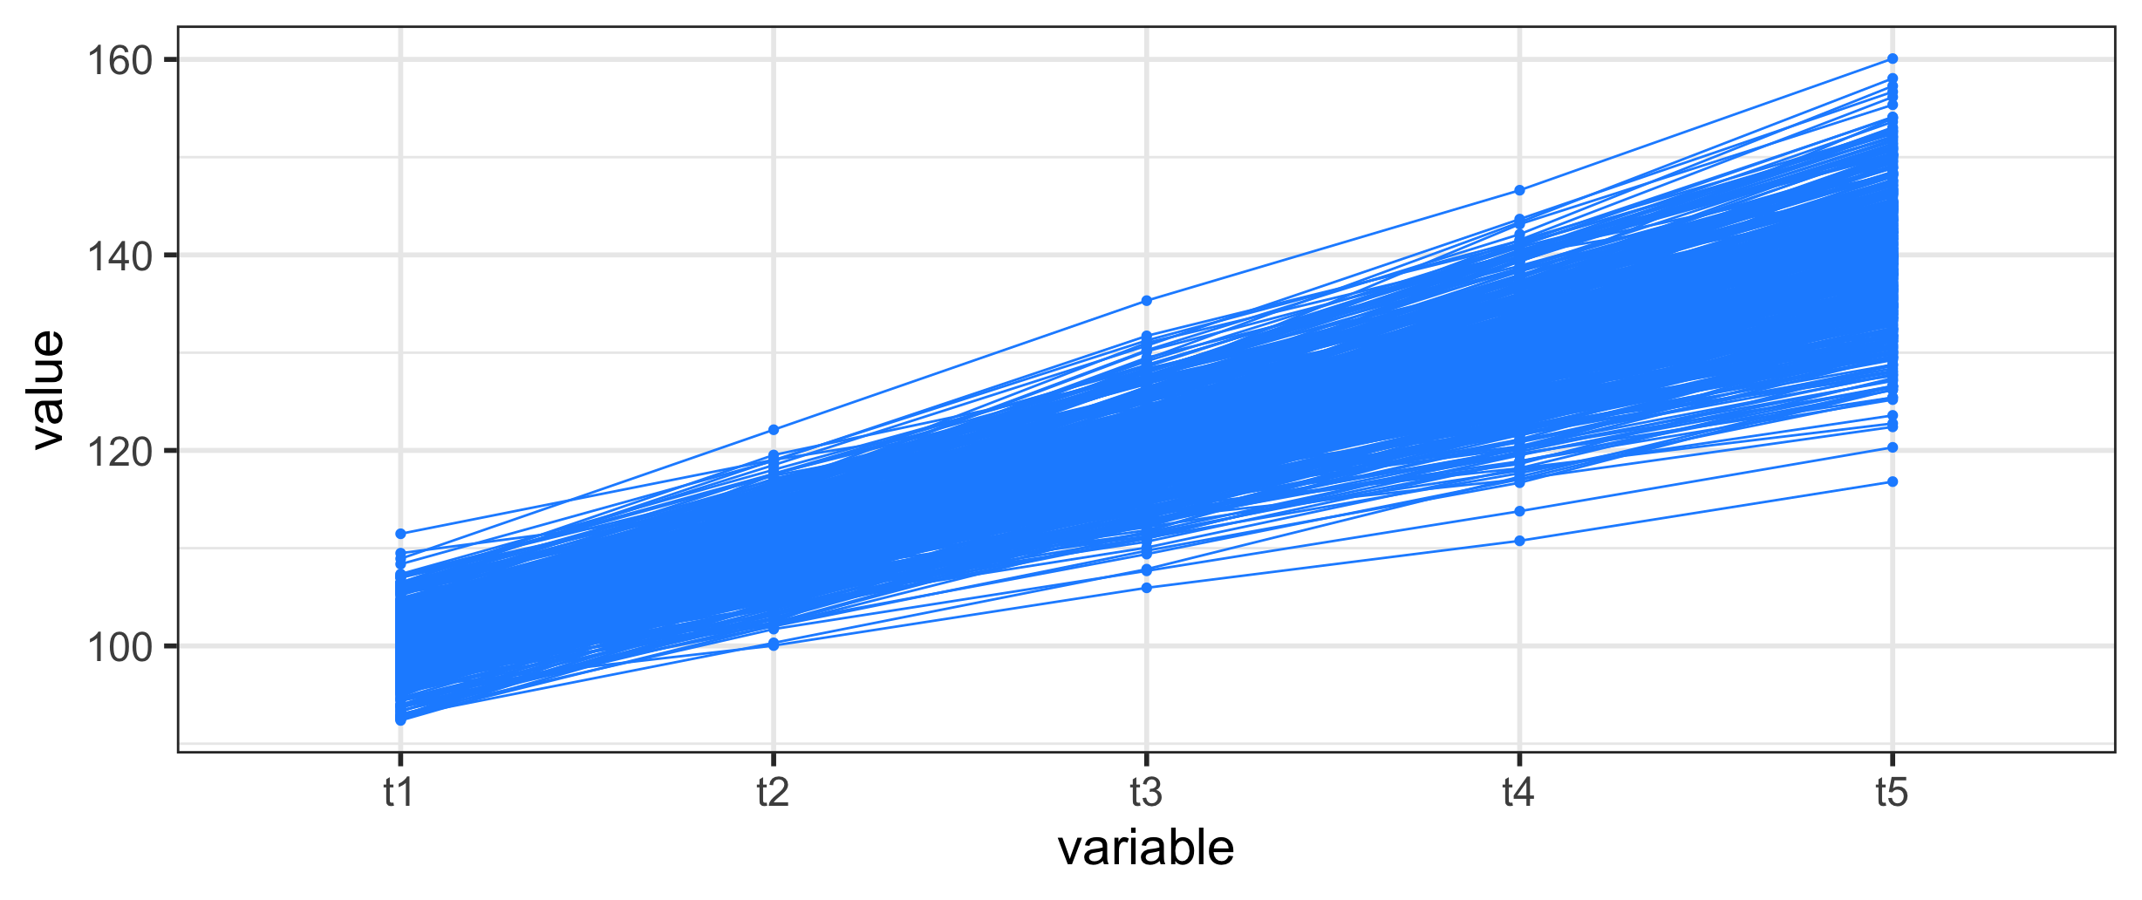
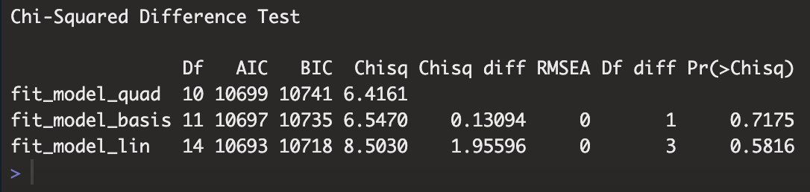
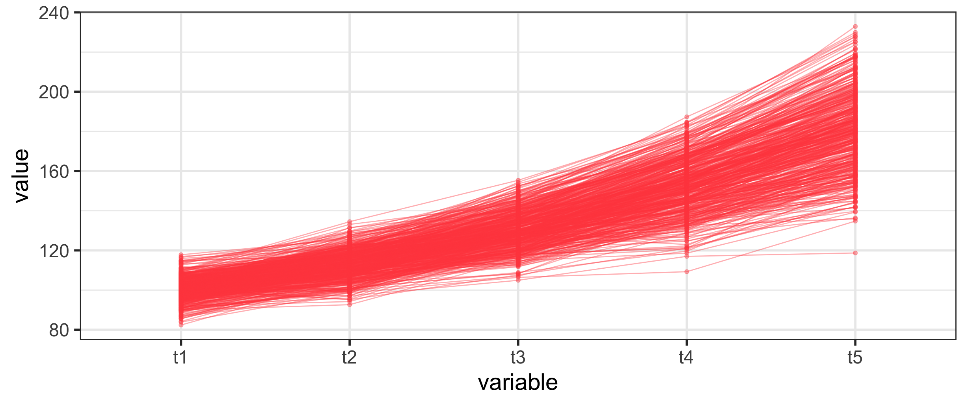
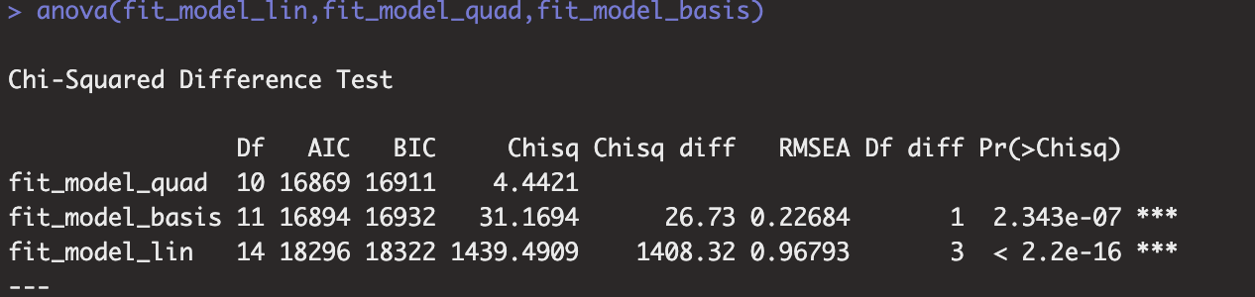
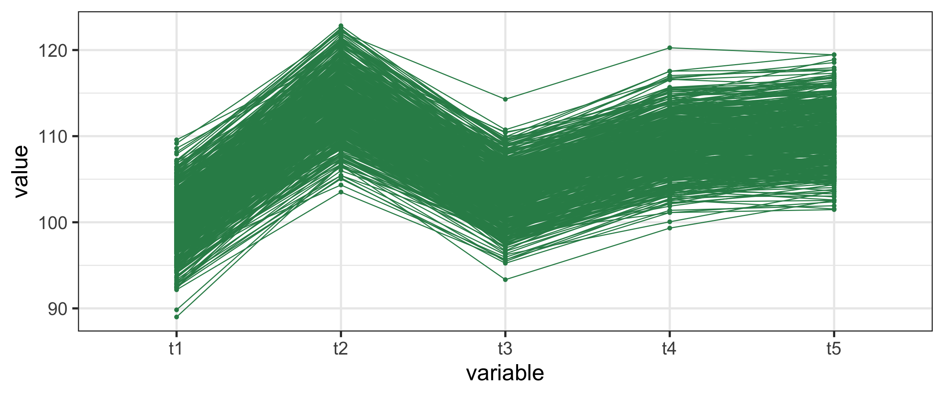
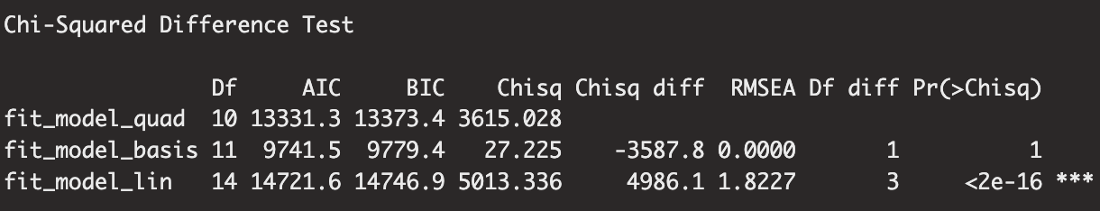

Slide 29

Léa Michel
Nick Judd
Magda Lazari

Slide 30
An introduction to Latent Growth Curve Modeling
Rogier A. Kievit
Lifespan Cognitive Dynamics Group
rogier.kievit@radboudumc.nl

Slide 31
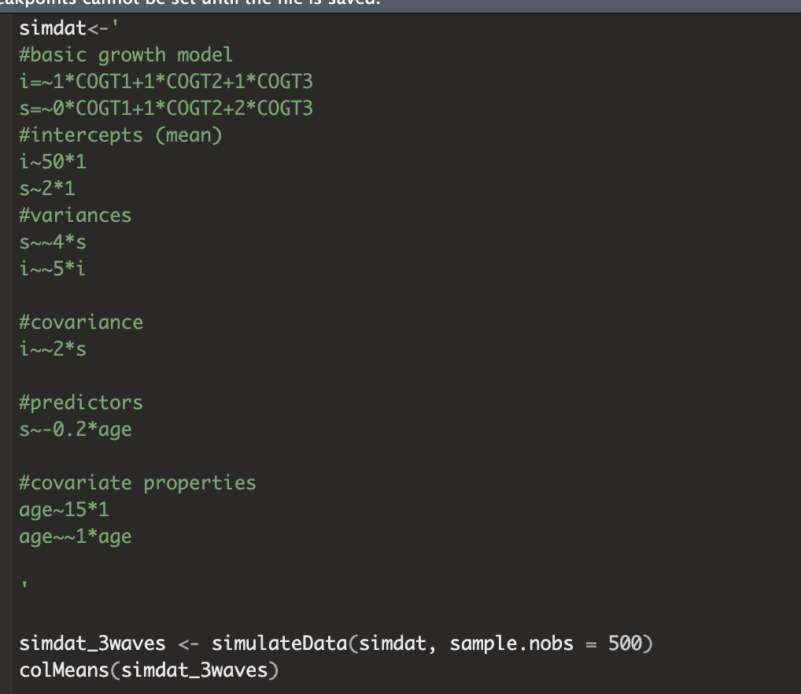
Simulating data in Lavaan

